Slide 1
DS 7333 – Quantifying the World
Live session - 1
Regularization

Slide 2
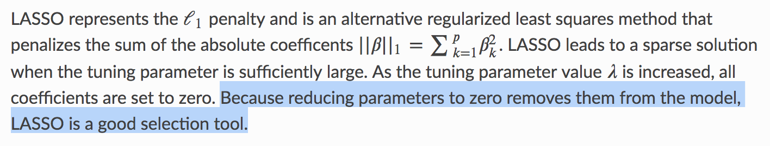
L1 Regularization LASSO (least absolute shrinkage and selection operator)
[Source]

Slide 3
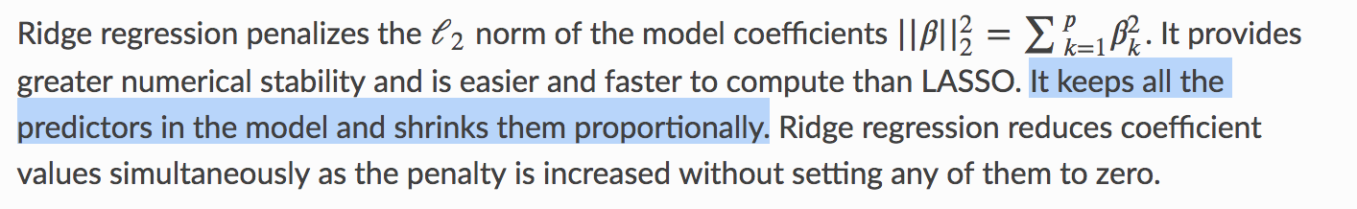
L2 Regularization Ridge Regression
[Source]

Slide 4
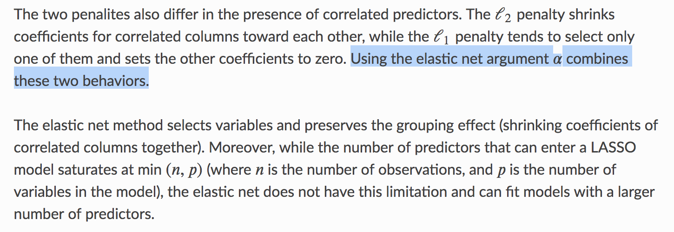
L1 & L2 Regularization Elastic Net
[Source]

Slide 5
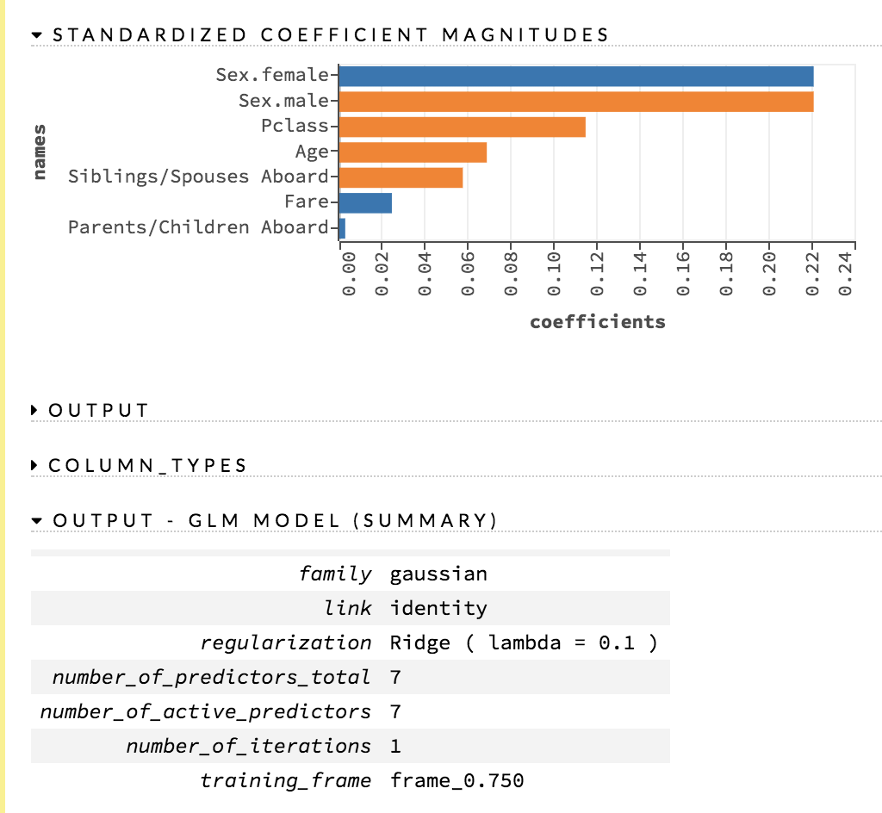
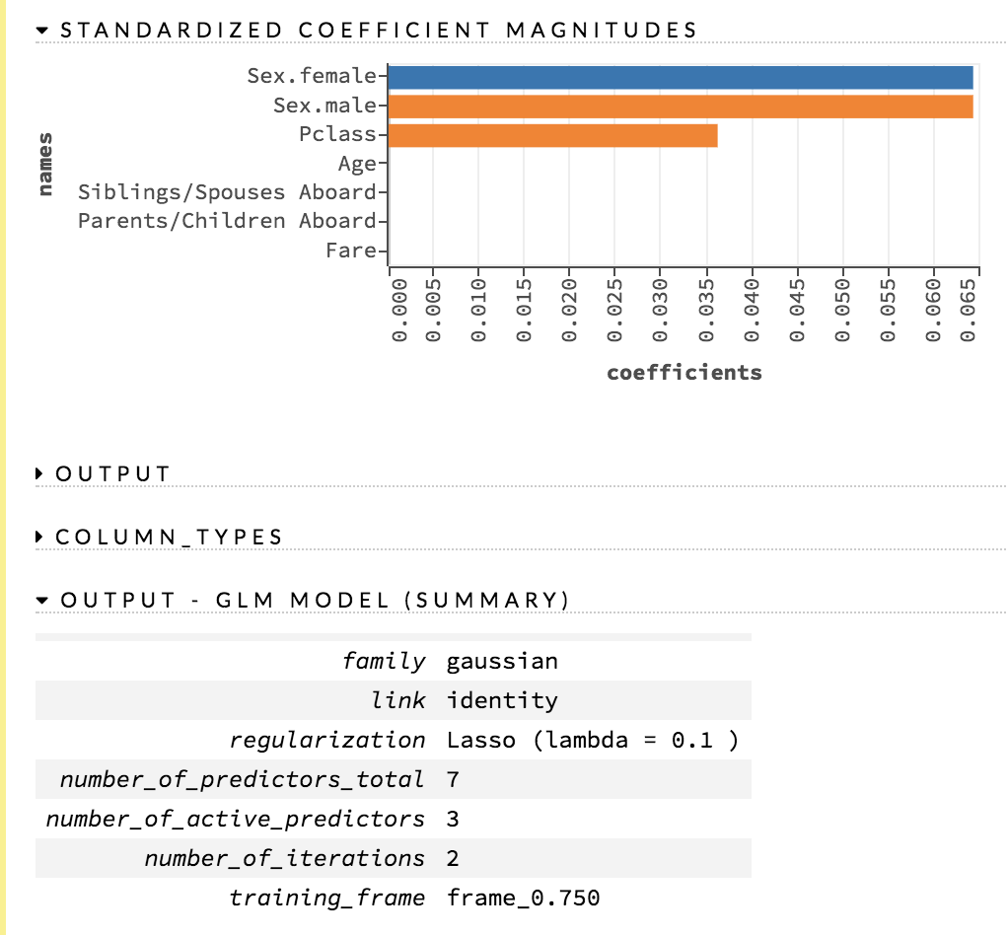
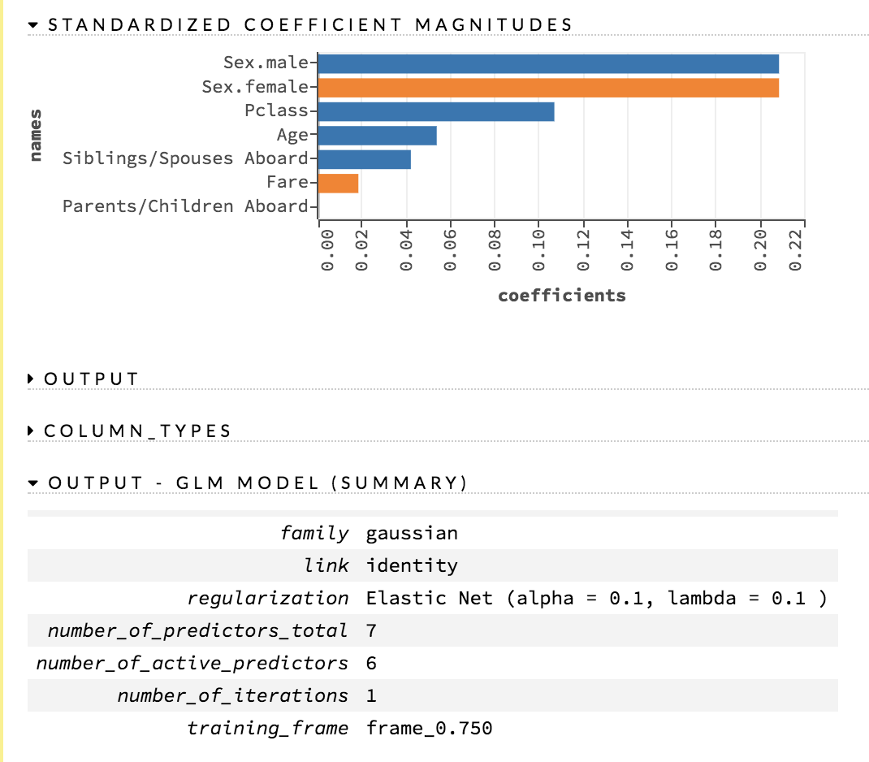
Impact of Regularization on Coefficients Ridge, LASSO, Elastic Net
[Source]

